Slide 1
CAPSTONE PROJECT
Notes Sharing Web Application using Django Framework
Presented By: ANU SHREE.K
1. ANU SHREE.K-VIVEKANANDHA COLLEGE OF TECHNOLOGY FOR WOMEN-ELECTRICAL AND ELECTRONICS ENGINEERING

Slide 2
OUTLINE
Problem Statement
Proposed System/Solution
System Development Approach
Algorithm & Deployment
Result
Conclusion
Future Scope
References

Slide 3
PROBLEM STATEMENT
Real-Time Collaboration Feature : Integrate real-time collaboration features into the application to enable multiple users to edit and view notes simultaneously, fostering better teamwork and productivity

Slide 4
PROPOSED SOLUTION
THE PROSED SOLLUTION AIMS TO DEVELOP A ROBUST NOTES SHARING WEBS APPLICATION USING PYTHON WITH DJANGO FRAMEWORK.THIS APPLICATION WILL FACILLIATE SEAMLESS SHARING AND COLLABORATION IMPLEMENT A SECURE USER AUTHENTICATION SYSTEM ALLOWING USERS TO SIGN UP LOG IN AND MANAGE THEIR ACCOUNTS SECURELY

Slide 5
SYSTEM APPROACH
This project aims to develop a feature-rich notes sharing web application using Python and the Django framework. Through an intuitive and customizable interface, users can create, organize, and share notes effortlessly. Leveraging advanced collaboration tools such as real-time editing and commenting, the platform facilitates interactive learning experiences and knowledge exchange. With emphasis on performance optimization and scalability, the application caters to the needs of diverse user communities, from students to professionals

Slide 6
ALGORITHM & DEPLOYMENT
Python: Utilize Python as the primary programming language for backend development due to its simplicity, versatility, and extensive libraries.
Django Framework: Leverage the Django framework for rapid development, built-in security features, and scalability.
HTML/CSS/JavaScript: Use these technologies for frontend development to create an intuitive and interactive user interface.
SQLite/PostgreSQL: Employ SQLite during development for its simplicity and switch to PostgreSQL for production for better scalability and performance.
RESTful API: Develop a RESTful API to facilitate communication between the frontend and backend, enabling seamless integration with other platforms and services.

Slide 7
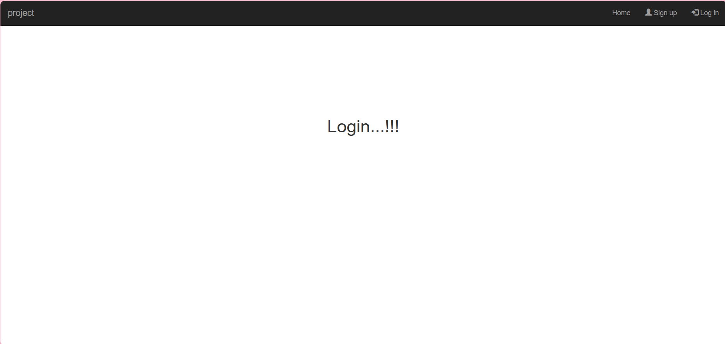
RESULT

Slide 8
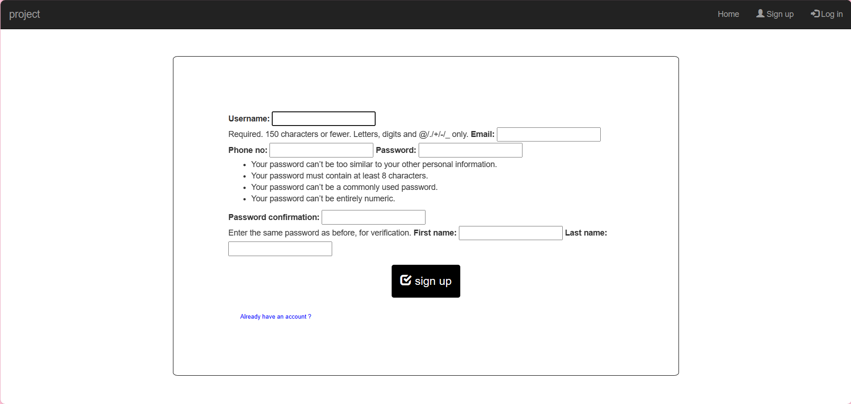

Slide 9
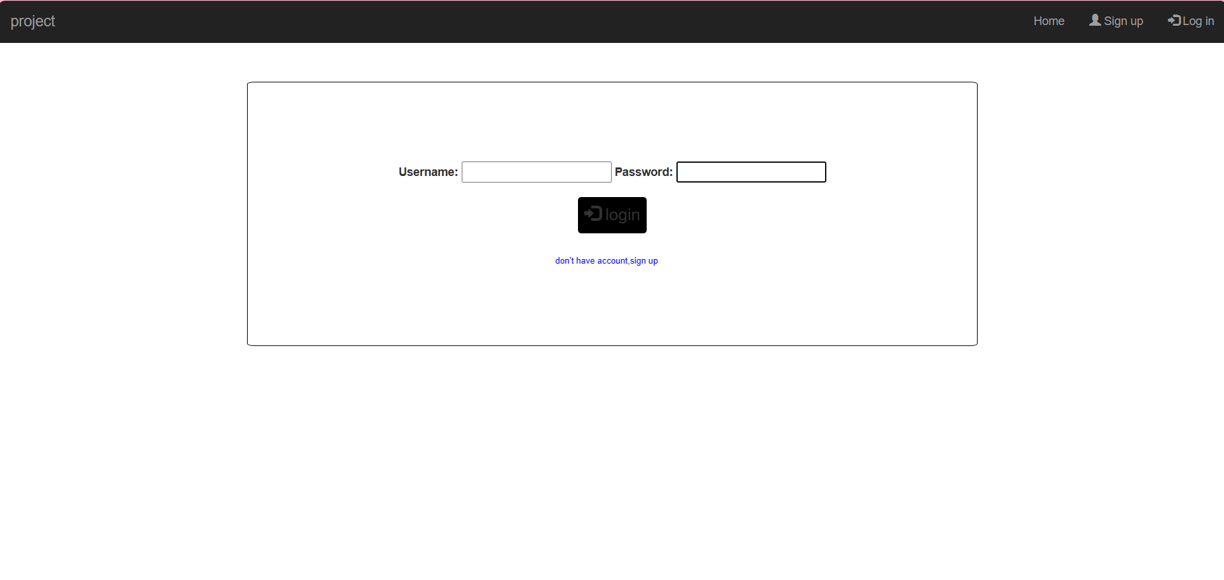

Slide 10
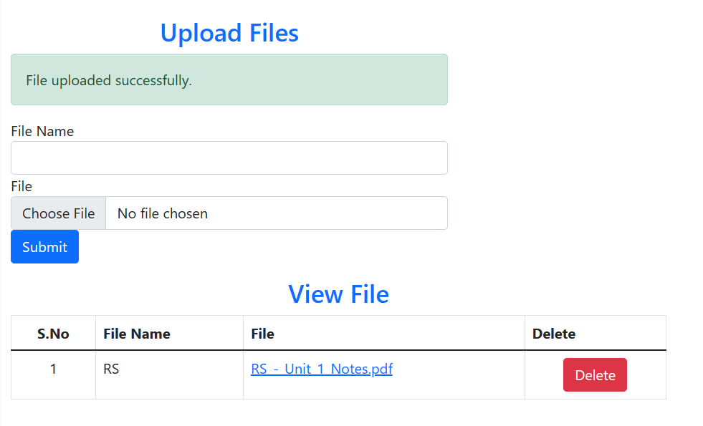

Slide 11
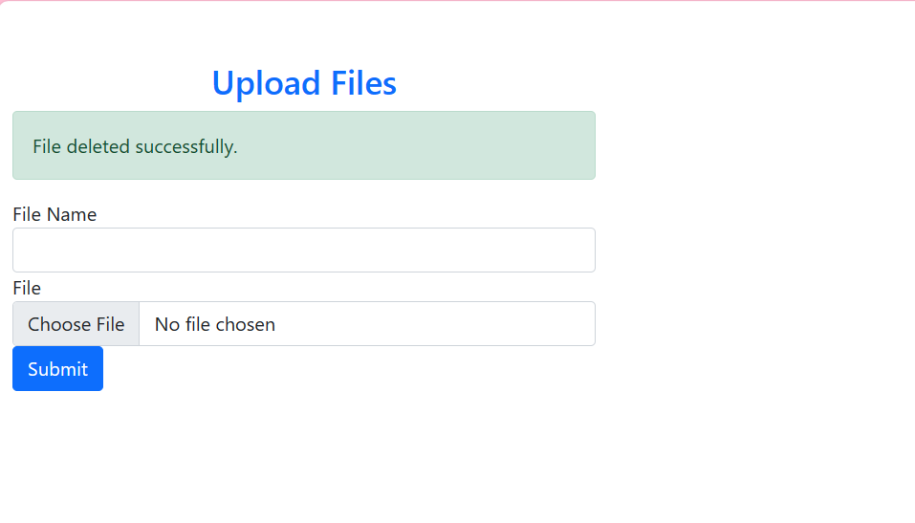

Slide 12
CONCLUSION
The proposed solution aims to deliver a feature-rich and scalable notes sharing web application that meets the needs of users seeking a platform for collaborative note-taking and knowledge sharing. By leveraging Python with the Django framework and following best practices in software development, the application will provide a seamless and secure user experience while enabling efficient collaboration and productivity.

Slide 13
FUTURE SCOPE
Ensure full mobile responsiveness to provide a seamless experience across various devices and screen sizes.
Consider developing native mobile apps for iOS and Android platforms to offer a more tailored and optimized experience.
Optimize database queries, caching mechanisms, and server-side processing to improve overall application performance.
Implement lazy loading techniques to efficiently handle large volumes of notes and improve page load times.

Slide 14
REFERENCES

Slide 15
THANK YOU

